Slide 1
Proposed Government Structure
November 2022

Slide 2
Village Assets
An excellent geographic location near major hospitals and universities
A strong commercial/industrial base with companies such as Proctor & Gamble, the J.M. Smucker Company and the Saint Bernard Soap Company
An independent school system as well as a well-known and respected parochial high school
A defined, architecturally significant downtown
A dedicated, engaged citizenry

Slide 3
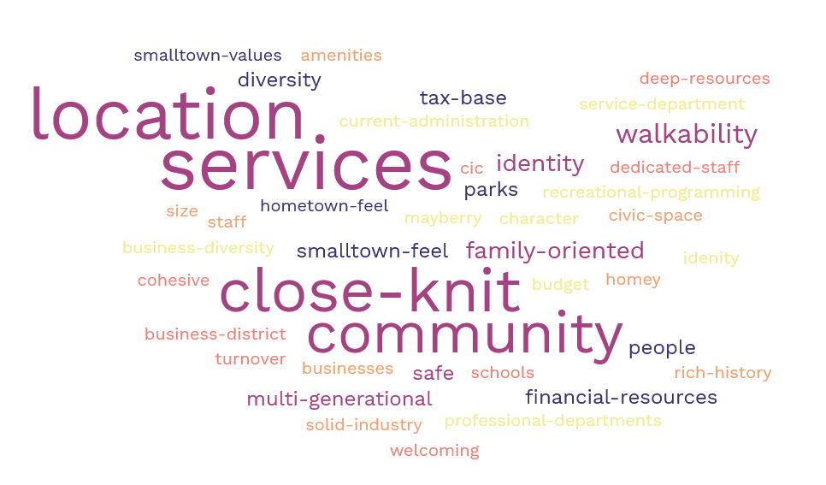
STRENGTHS

Slide 4
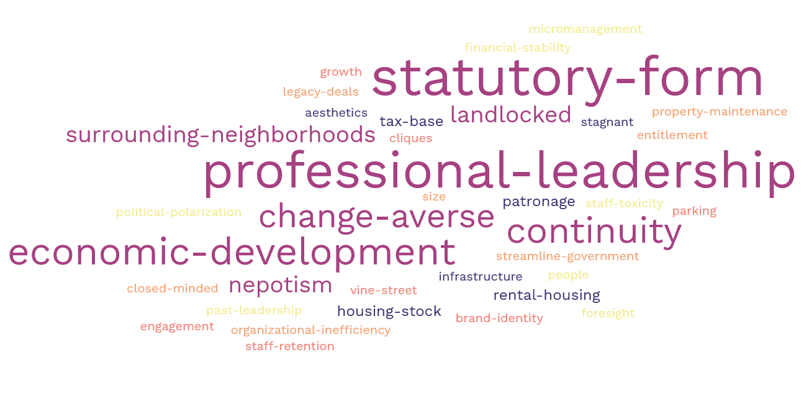
CHALLENGES

Slide 5
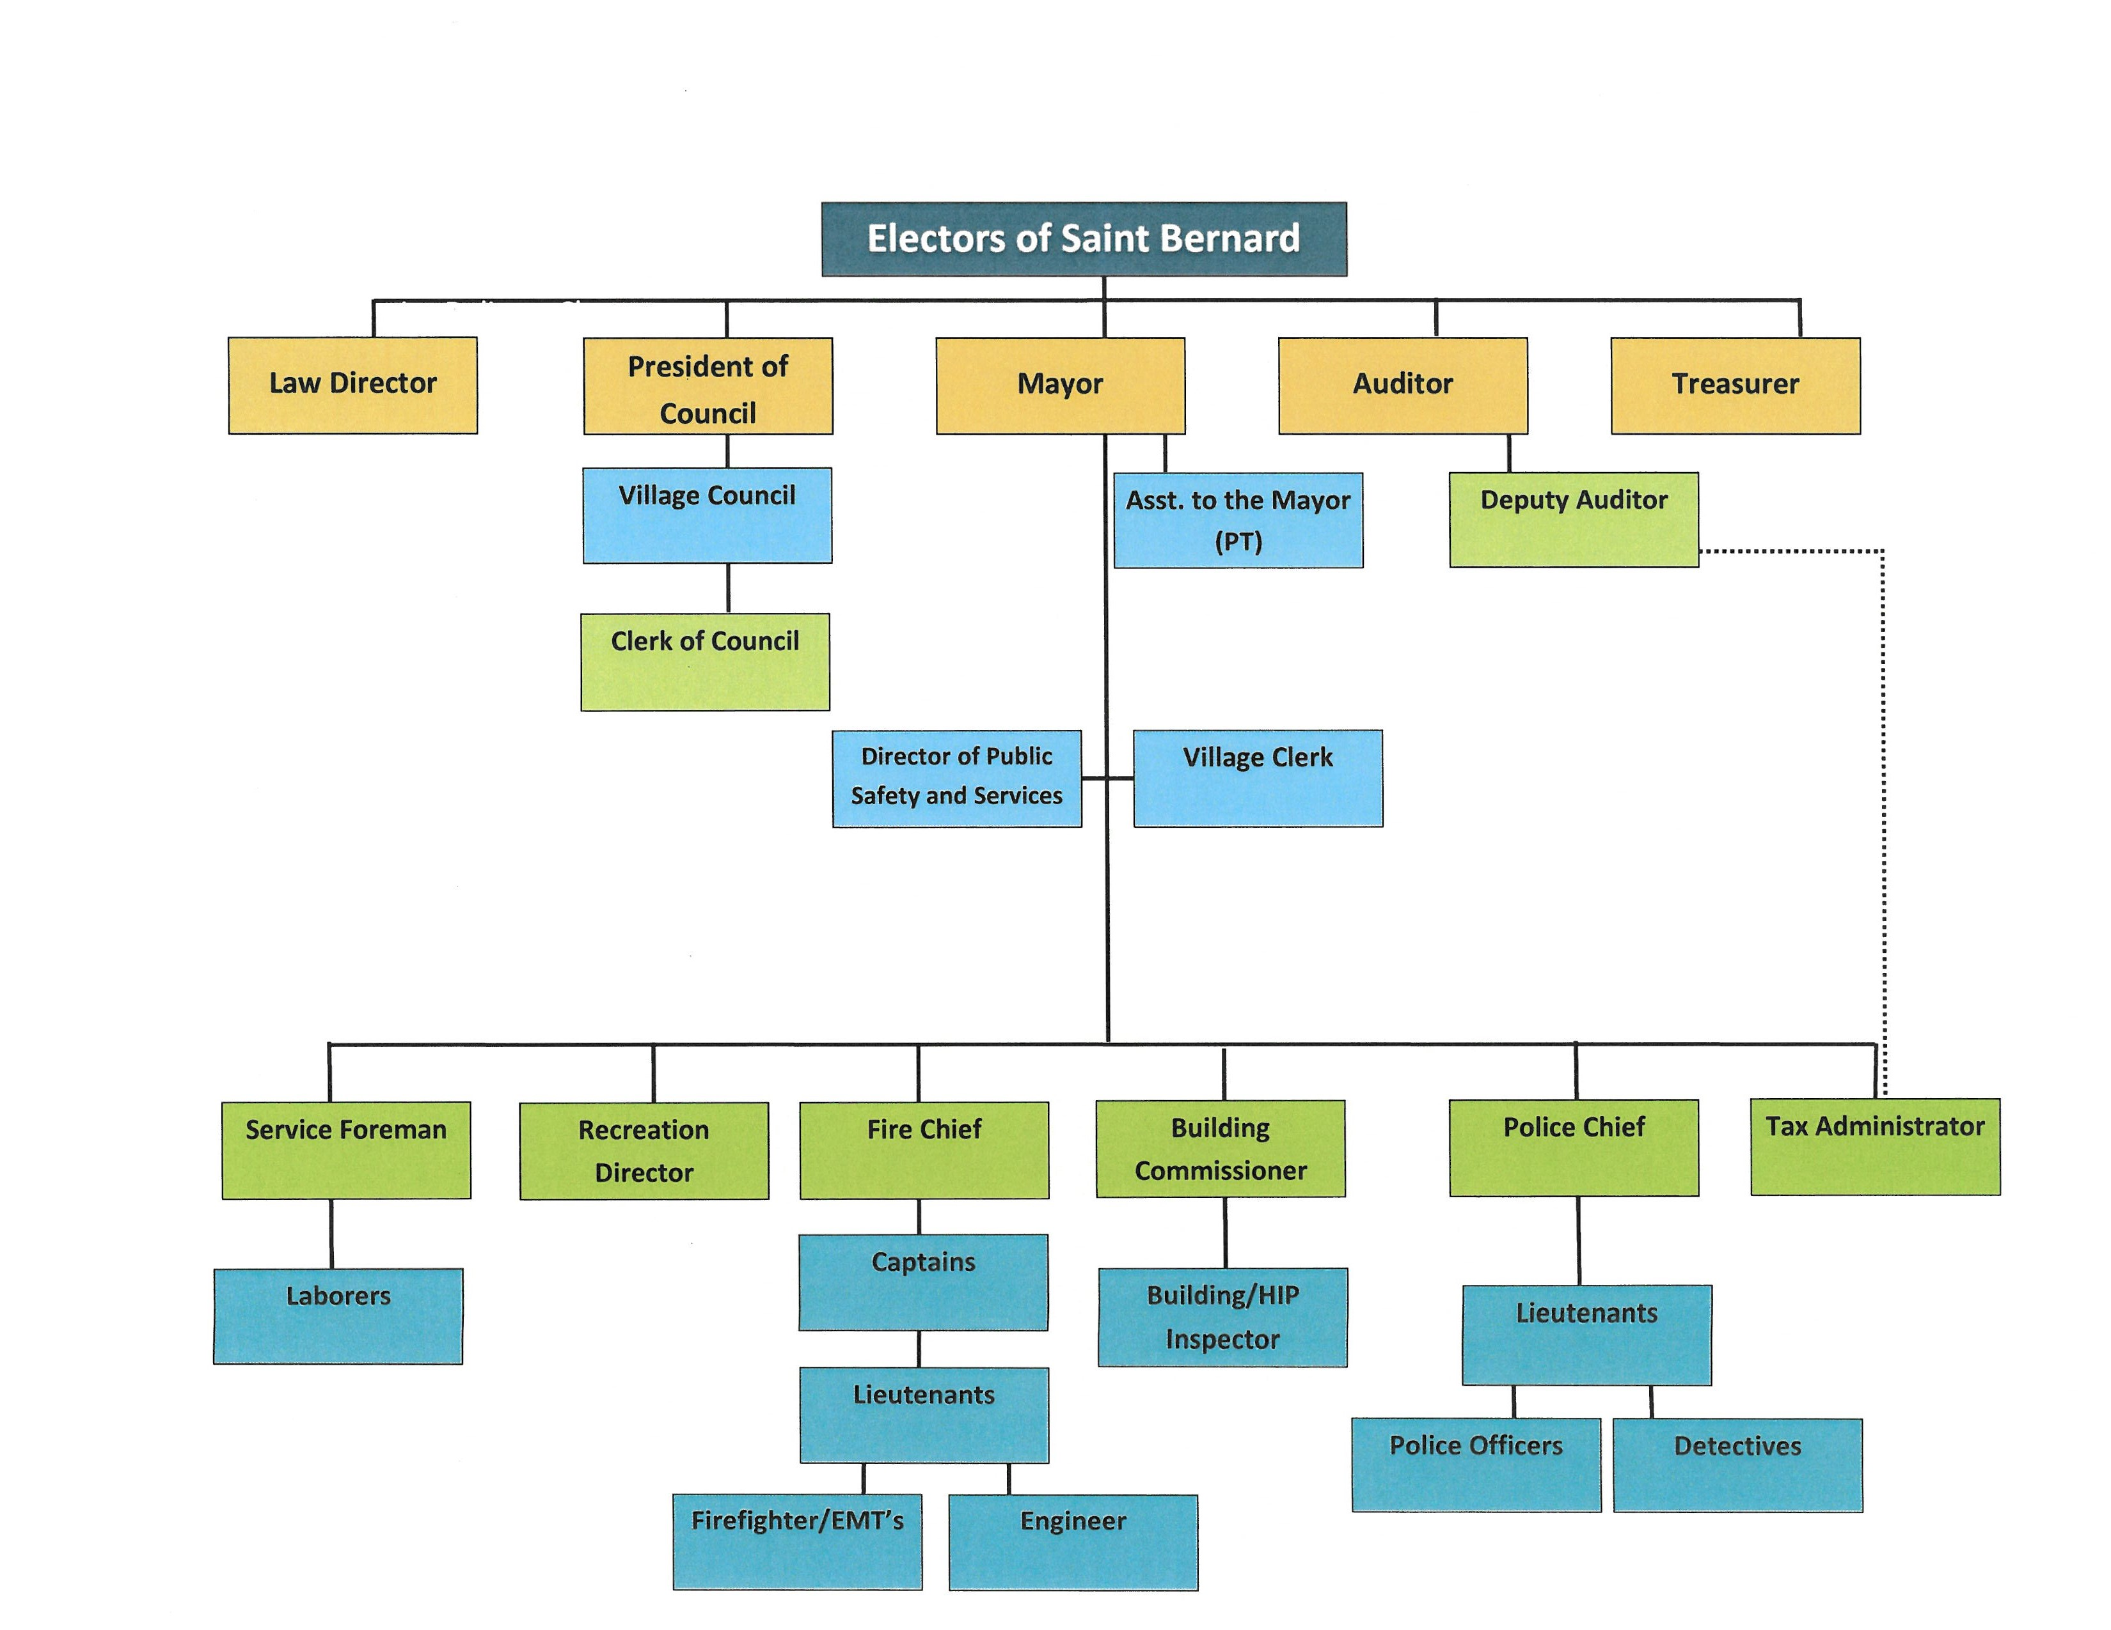
Current Structure

Slide 6
Potential Forms of Government
Statutory (Current Structure)
Mayor – Council (Strong Mayor)
Council – Manager (Village Manager)

Slide 7
Statutory
General Law Form of Government
Three Principal Elected Administrators: - Mayor - Auditor - Law Director
Provides for a Safety-Service Director
Multiple Appointment Authorities -Mayor -Auditor -Park Board -Recreation Board -Law Director

Slide 8
Mayor-Council
Mayor is directly elected - serves as Chief Executive Officer - has appointment authority over all Village staff - prepares and presents budget to Council for approval
Council can be elected at-large or from wards -responsible for enacting laws and setting policy -possesses the power of appropriation
May provide for a Municipal Administrator -serves as Chief Administrative Officer - oversees the day-to-day operation on behalf of the Mayor -assists with preparation and presentation of the budget

Slide 9
Council-Manager
Village Council possesses all power and authority to set policy
The Mayor can be selected from amongst council members or can be directly elected -serves as the Chief Elected Official -functions as the ceremonial head-of-government - has the right to introduce legislation and to take part in discussion of all matters before Council with the right to vote in the event of a tie
A non-partisan Municipal Manager is appointed by Council to serve as the Chief Executive Officer - is selected based upon merit and professional credentials - has appointment authority over all Village staff - prepares and presents budget to Council for approval

Slide 10
Proposal
A hybrid between the Mayor-Council and the Council-Manager forms-of-government wherein:
The Mayor would be directly elected and would retain ultimate appointment authority
The Safety-Service Director position would transition to a Municipal Administrator position to oversee the day-to-day operations of the Village
The Municipal Administrator would be appointed based upon merit and professional credentials with the power to appoint village staff with the consent of the Mayor
The elected Auditor and Treasurer positions would be combined into an appointed professional Finance Director position
The elected Law Director would transition to an appointed Law Director with expertise in Municipal Law

Slide 11
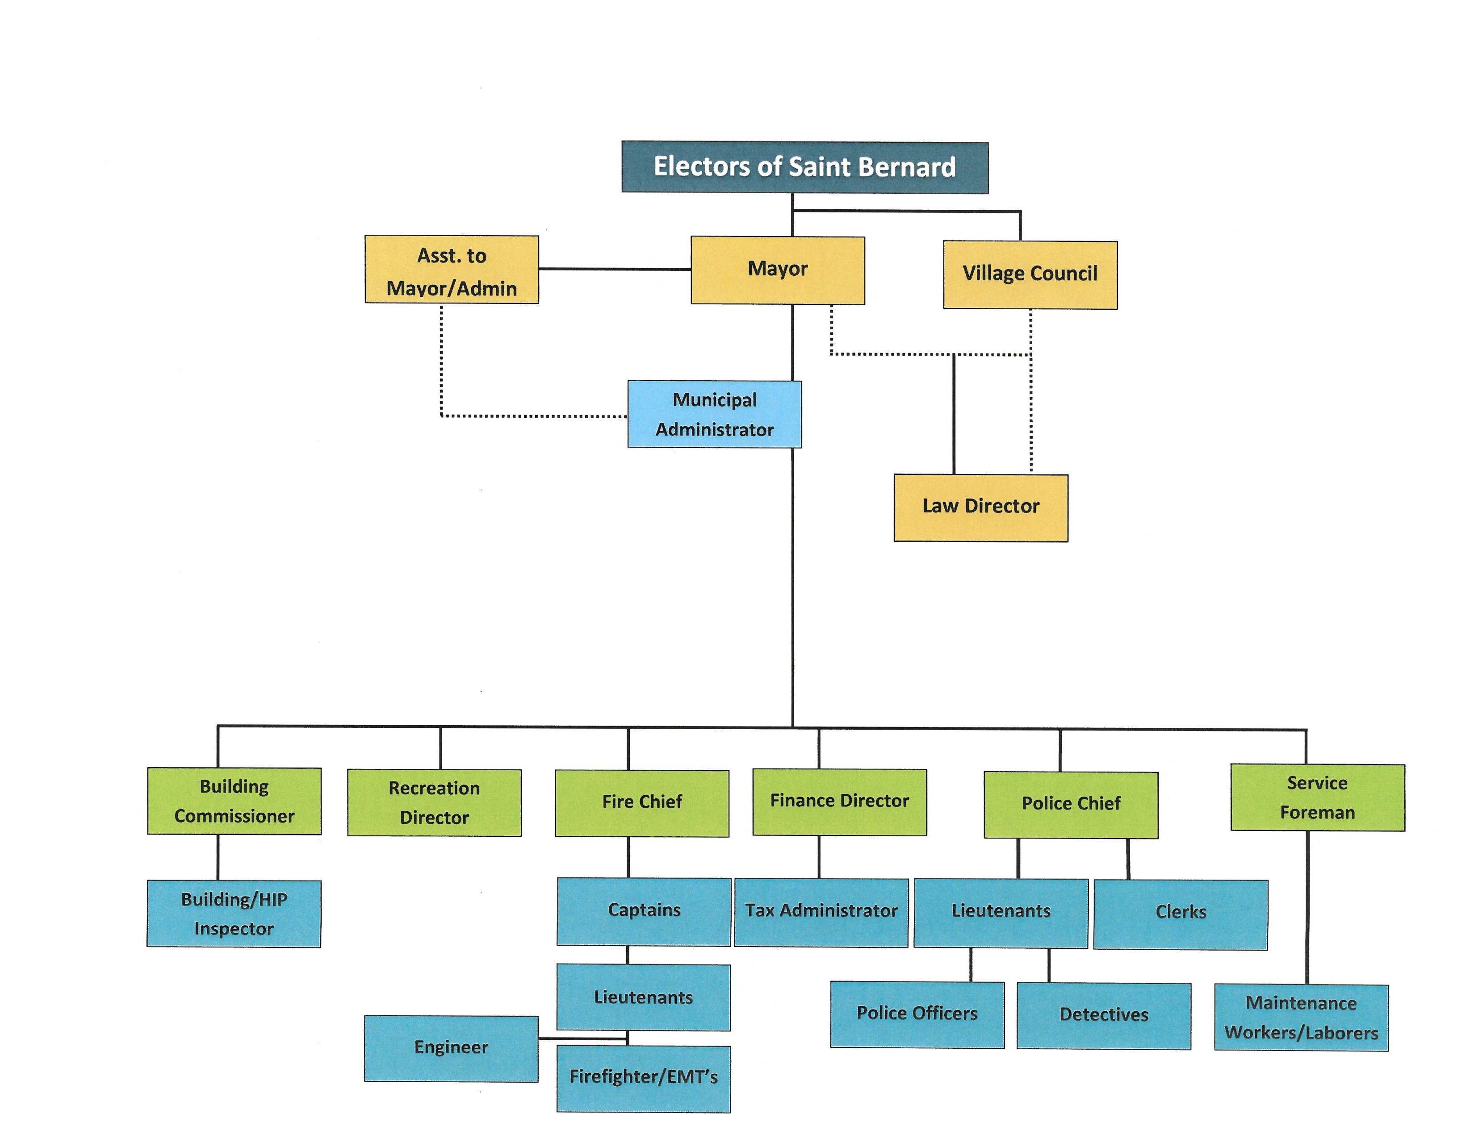
Proposed Structure

Slide 12
Transition
Statutory Model to Charter Model
Director of Public Safety and Service to Municipal Administrator
Auditor & Treasurer combined into Finance Director
Elected Law Director transition to Appointed Law Director

Slide 13
Next Steps
1. Gather input via:
Social Media
Village Website
Public Forums
Village Newsletter
2. Finalize Charter language
3. Place Charter amendments on the May 2023 ballot

